Slide 1
Matlab Analysis Code
2017 11 22 update

Slide 2
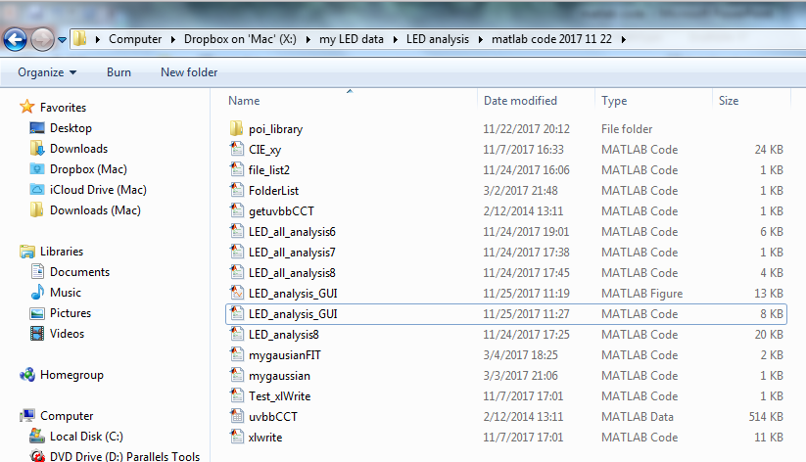
Open the folder with the source code.
Double click “LED_analysis_GUI.m”
Choose the MATLAB CODE, not MATLAB FIGURE.
Note: Do not delete any other files from the folder.

Slide 3
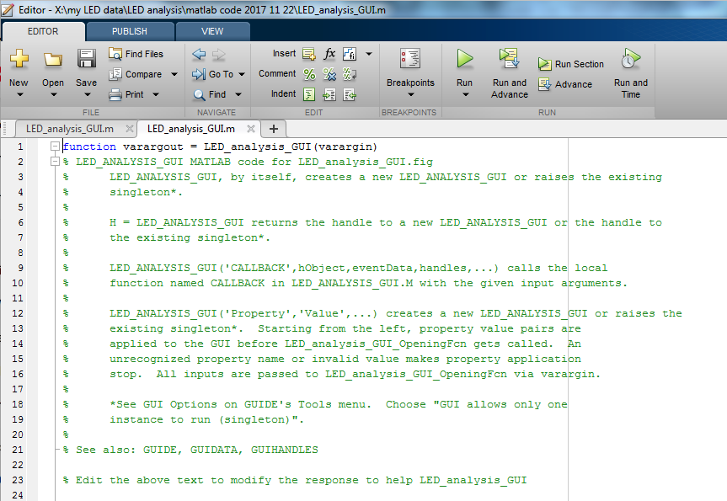
Go to the EDITOR
click “Run”

Slide 4
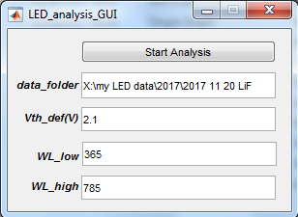
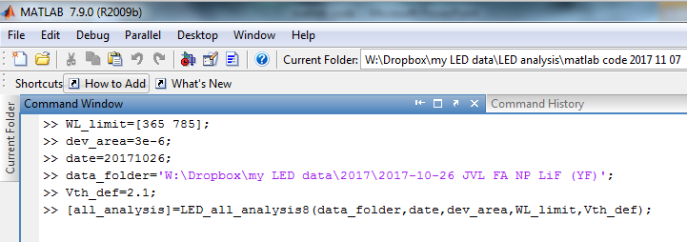
Simple User Interface
Click to begin analysis
Key in parameters:
Full address of data folder
a dummy parameter to ignore any data below V = Vth_def
Lower wavelength limit for EQE calculation
Upper wavelength limit for EQE calculation
No requirement to key “date” and “dev_area”: updated code to extract from meta file automatically
No Manual Code Entering!

Slide 5
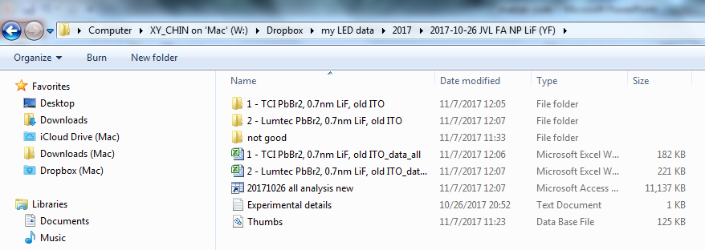
After the code finished running.
Auto-save / generate one excel file for each data folder
Auto-save/ generate matlab workspace file

Slide 6
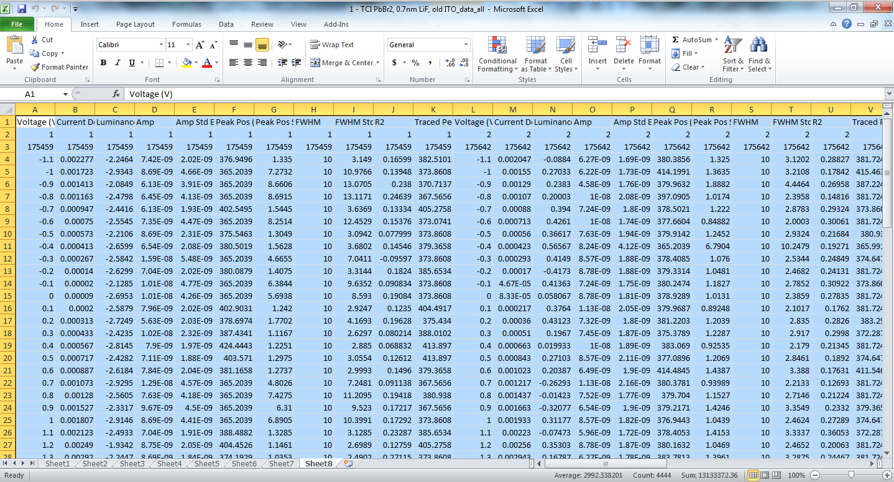
Excel Files
8 data sheets with different information

Slide 7
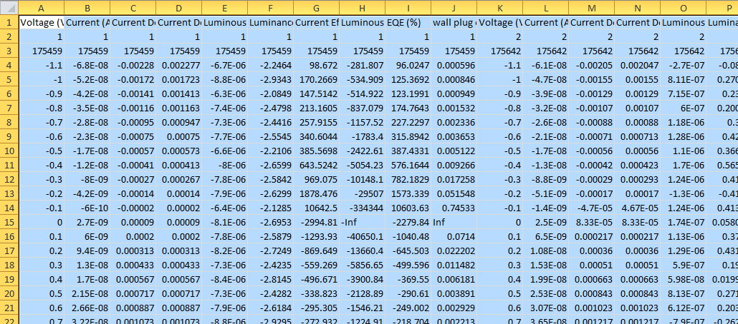
Excel: sheet 1
First row: header with unit
Second row: index of device
Third row: time of measurement
Fourth row onwards: data…
Voltage
Current
Current density
Absolute value of Current density
Candela
Luminance
C.E.
L.P.E.
EQE
Wall plug effciency

Slide 8
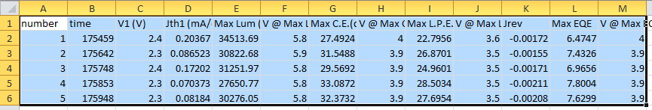
Excel: sheet 2
Summary of data:
Index of device
Time of measurement
Turn-on voltage
Turn-on current
Max Luminance
V@ Max Luminance
Max C.E.
V@ Max C.E.
Max L.P.E.
V@ Max L.P.E.
Reverse current density
Max EQE
V@ Max EQE

Slide 9
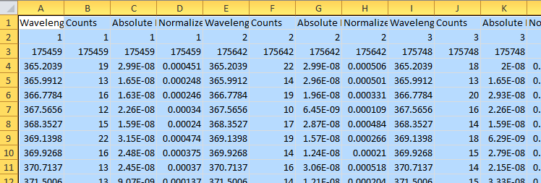
Excel: sheet 3
Spectrum @ Max Luminance
First row: header with unit
Second row: index of device
Third row: time of measurement
Fourth row onwards: data…
Wavelength
Counts
Absolute Irradiance
Normalized Absolute Irradiance

Slide 10
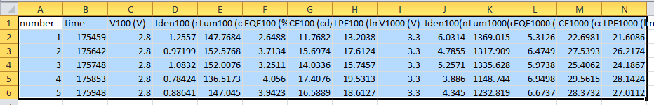
Excel: sheet 4
Summary of data:
At 100 and 1000 cd/m2
Voltage
Current Density
1st Luminance >= 100 (or 1000) cd/m2
EQE
C.E.
L.P.E.

Slide 11
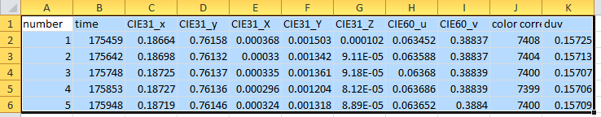
Excel: sheet 5
Summary of data:
At Max Luminance:
CIE 1931 (x,y)
CIE 1931 (X,Y,Z) (unnormalized)
CIE 1960 (u,v)
Color correlated temperature (CCT)
duv: “distance” to ideal black body source @ CCT

Slide 12
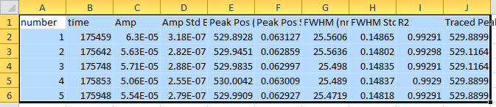
Excel: sheet 6
Summary of data:
At Max Luminance:
Amplitude + error of fitting
FWHM + error
Peak position + error
R² of the fitting
Maximum of original data
Note: fitted with single gaussian peak
y = Amp*exp(-(4*log(2))*((xdata-X)/(FWHM)).^2);

Slide 13
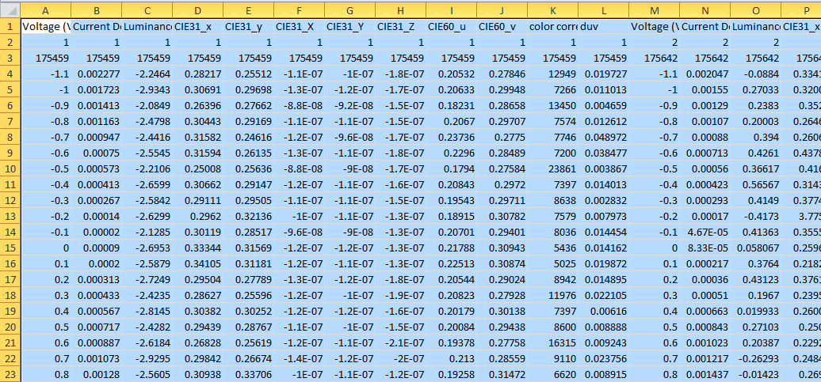
Excel: sheet 7
As a function of Voltage (Current density and Luminance also given):
CIE 1931 (x,y)
CIE 1931 (X,Y,Z) (unnormalized)
CIE 1960 (u,v)
Color correlated temperature (CCT)
duv: “distance” to ideal black body source @ CCT

Slide 14
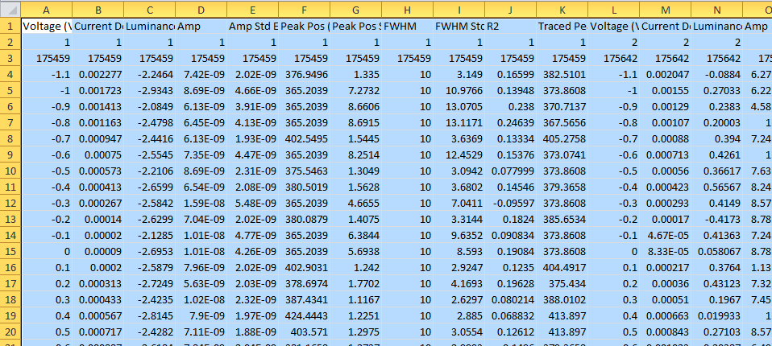
Excel: sheet 8
As a function of Voltage (Current density and Luminance also given):
Amplitude + error of fitting
FWHM + error
Peak position + error
R² of the fitting
Maximum of original data
Note: fitted with single gaussian peak

Slide 15
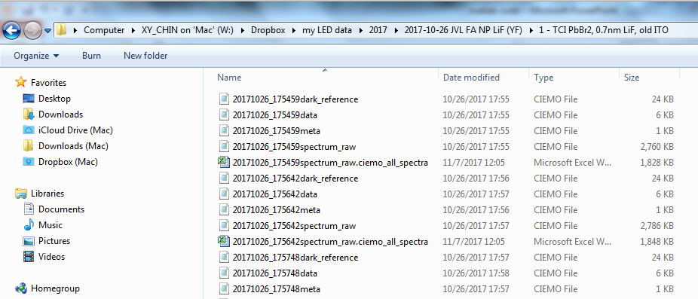
Also generate/auto-save a “spectra” excel file for each measurement
Each contains 4 data sheet

Slide 16
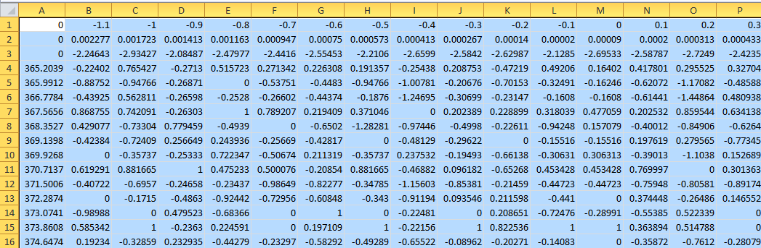
Spectra files
First row: voltage
Second row: current density
Third row: Luminance
First Column: wavelength
The rest: abs. irradiance
4 data sheet:
Sheet 1: interpolated data (WL step of 1nm)
Sheet 2: original data
Sheet 3: Normalized data of Sheet 1
Sheet 4: Normalized data of Sheet 2

Slide 17
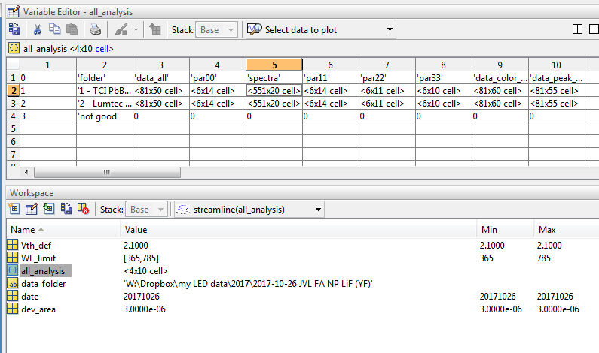
If you have Matlab…..
Organized according to folder
“all_analysis” contains all of the data

